Slide 1
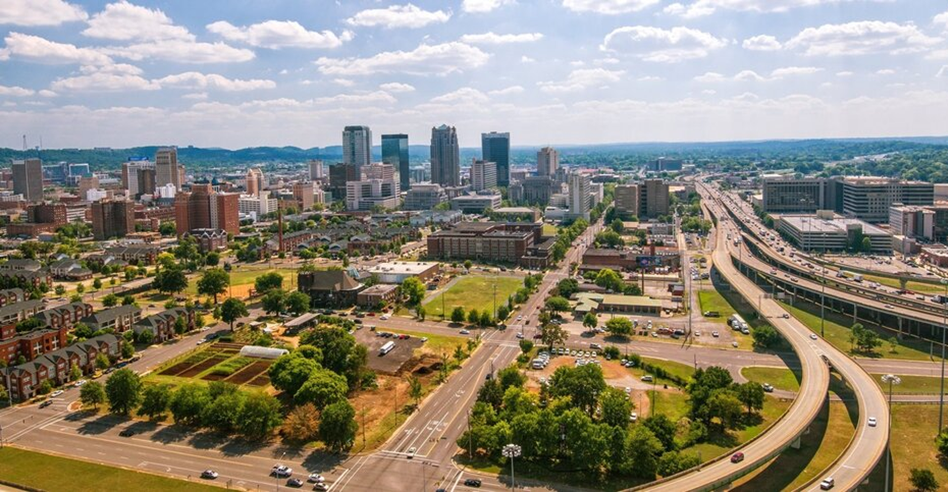
PUBLIC HEARING HUD One Year Action Plan 2025-2026 City of Birmingham Community Development Department Virtual: JANUARY 8, 2025 at 9:30 AM & JANUARY 9, 2025 at 9:30 AM In-Person: January 9, 2025 at 5:30 PM at City Hall’s Council Chambers on the 3rd Floor

Slide 2
HUD Action Plan Development 2025-2026
Public Hearing Agenda
Welcome & Introductions
Organization Chart
One Action Plan Summary
Application Schedule & Guidelines
PY 2025 HUD Formula Allocation Amounts
CDBG Program Limitations
HOME, HOPWA & ESG Programs
Application Overview
Deadline for Proposals
Questions & Comments

Slide 3
COMMUNITY DEVELOPMENT DEPARTMENT
2025 Organization Chart
Director
Dr. Meghan Venable-Thomas
Director
Land Bank
Caroline Douglas
Project Manager
Porchia Rawls
Deputy Director
CRSD
Alice Williams
Deputy Director
Public Service/Grants
Senior Deputy Director
Cory Stallworth
Deputy Director
Kelvin Datcher
Community Resource
Public Service/Grants
Housing
Administration
Accounting
Land Bank
Sr. CRR
Jason Walton
Prin. Acct.
Thomas Stone
Grants Administrator
Randi Foy
Sr. Project Manager
Courtney Newton
Training & Org. Dev. Coordinator Vacant
Chief Admin Analyst
Otisa Walker
Land Bank Administrator Joanne Burl
CRR
Melony Martin
Admin Clerk
Vacant
Sr. Admin Analyst
Yashika Hamilton
Project Manager Lareisha Higginbottom
Public Relations Coordinator
Chelsi Law
Admin Analyst Carrie Hutchinson Underwood
Paralegal
Vacant
Sr. GMC
Synette Gandy
Admin Analyst Vacant
Project Manager Christopher Ngigi
CRR
Andrea Watson
Admin Clerk
Krystal Griffin
Principal Administrative Analyst Keona Nixon
GMC
Julius Howard
Principal HRS
Vacant
Sr. Urban Designer Erica Chisolm
Admin Analyst
Montrese Daniels
Admin Assistant
Kimberly Warren
CRR
Harold Houston
Sr. Accountant Jevon Larkins
GMC
Tondra Mack
Sr. HRS
Randall Cornelius
Sr. Admin Analyst
Monica Leach
CRR
Herman Lumzy
Accountant
Briana Townsend
HRS
Armand Richardson
GMC
Mattrice Pride
Sr. HRS
Niles Williams
Unit Clerk Deja Peoples
CRR
Flora Johnson
GMC
Zabrina Hudson
Sr. HRS
Vacant
Admin Analyst
Jessica Chapman
Accountant Shakir Hason
CRR
Ceara Benson
GMC DJ Ramirez
HRS
Mattheas Simon
Admin Analyst
Keandria Nalls

Slide 4
HUD Action Plan Development 2025-2026
Consolidated Plan & One Year Action Plan Summary
One Year Action Plans are the plans and budgets for HUD CDBG, HOME, HOPWA and ESG funds for each year guided by the needs and priorities set in the 5-Year Consolidated Plan.
CDBG Funds can be used in a flexible manner for economic development, improvements to parks and open space, needed public services, and affordable housing projects and programs.
HOME Investment Partnership Funds can be used to further affordable housing programs and projects.
Housing Opportunities for Persons With AIDS can be used for a wide range of housing, social services, program planning, and development costs.
Emergency Solutions Grant (ESG) Funds are to be used to support homeless prevention and rapid re‐housing programs.
The goal of this document and these HUD funds is:
“to develop viable urban communities by providing decent housing and a suitable living environment and expanding economic opportunities principally for low‐and moderate‐income persons.”

Slide 5
HUD Action Plan Development 2025-2026
Application Schedule & Guidelines
The One Year Action Plan approval schedule and application guidelines are available on the Community Development Department Webpage at www.cobcd.com
Applications will be evaluated based on, but not limited to, the following categories:
Community Need – Does the grant address goals and objectives expressed in the Consolidated Plan
Program Description & Effectiveness – Is the proposal realistic, clearly defined and measurable
Agency Management – Does the agency maximize resources in a well-run, coordinated effort
Readiness to proceed – Timeframe to initiate program services and expend funds
Partnership/Collaboration – Relationship with other agencies and leveraging of funds
Project Description….………...…………………………………………..........15 points
Community Need …….…………………….…………………………….………..35 points
Agency Management….………..…………………………………….............10 points
Readiness to proceed………………………………………………….……......20 points
Project budget…………………………………………………........................10 points
Partnership/Collaboration…………………………................................5 points
Complete Application………………………………..................................5 points

Slide 6
HUD National Objectives
Benefit to Low-to-Moderate Income Individuals/Areas
Prevent or Eliminate Slum/Blight
Meet an Urgent need that Threatens the Health or Welfare of Residents

Slide 7
Goals of the Program
Decent, Safe and Sanitary Housing
Suitable Living Environments and Neighborhoods
Expand Economic Development Opportunities

Slide 8
Planning and Administration:
Preparation of general plans such as the Consolidated Plan
Day to day management of housing-rehab program
Management of environmental and historic preservation related issues
Compliance with rules such as: Environmental Review Standards, Federal Labor Standards (Davis Bacon Act), Section 3 Requirements
General Program Administration
Includes general management, office supplies, training, travel and salaries
Includes public information, indirect costs, and preparation of applications for federal funds

Slide 9
HUD Action Plan Development 2025-2026
CDBG Program Limitations
CDBG Public Service Activities Are By CDBG Regulation Limited To 15% Of CDBG Grant Funds And Anticipated Previous Year Income. (Projected $5,810,968)
CDBG Planning and Management/Administration Activities Are By CDBG Regulation Limited To 20% Of CDBG Grant Funds And Anticipated Program Income. (Projected $1,162,193.60)
An eligible range of activities include, but not limited to:
Public improvements such as streets, curbs, gutters, sidewalks, parks, playgrounds, water and sewer facilities, flood and drainage improvements, community, senior and health centers, homeless shelter improvements, etc.
Housing rehabilitation
Administration
Public service activities including homeless shelter and other public service activities
Neighborhood revitalization
Commercial Revitalization/Economic Development/Workforce Development
Historic Preservation

Slide 10
HUD Action Plan Development 2025-2026
PY 2025 HUD Formula Allocation Amounts
HUD has not yet announced the official allocations for PY 2025 based on overall Budget allocations from The Congress. This is a projected budget based on PY 2024 allocations.
CDBG HOME HOPWA ESG
2024: $5,810,968 $1,322,100.02 $1,788,325 $518,372

Slide 11
HUD Action Plan Development 2025-2026
HOME
CHDO Set Aside Are By HOME Regulation Limited To 15% Of HOME Grant Funds And Anticipated Previous Year Income. (Projected $183,315.00)
HOME Management/Administration Activities Are By HOME Regulation Limited To 10% Of HOME Grant Funds And Anticipated Program Income. (Projected $122,210.00)
An eligible range of activities include:
Administration and Community Housing Development Organization (CHDO) activities.
Homebuyer Assistance.
New Construction (Single & Multi-Family).
Rental Rehabilitation (Single & Multi-Family).
Comments, suggestions and proposals relating to the possible overall use of PY 2025 HOME funds by the City in accordance with the eligible activities referenced are encouraged and will be considered.

Slide 12
HUD Action Plan Development 2025-2026
HOPWA
HOPWA Program (Projected allocation $1,788,325): AIDS Alabama, Inc. presently serves as the City’s sponsor of HOPWA Entitlement Funds. A description of proposed activities is included as a part of the City’s PY 2025 Proposed Action Plan. However, comments and suggestions relating to the possible overall use of PY 2025 HOPWA funds by the City in accordance with the eligible activities referenced are encouraged.
An eligible range of activities include:
Permanent Housing Placements
Short Term Mortgage, Rent, Utility Assistance (STRMU)
Tenant Based Rental Assistance (TBRA)
Hotel/Motel Vouchers
Food Assistance

Slide 13
HUD Action Plan Development 2025-2026
ESG
ESG Program (Projected allocation $518,372): The City intends to apply for 2025 ESG funding through the U.S. Department of Housing and Urban Development and through the Alabama Department of Economic and Community Affairs (ADECA). ESG proposals received through the City’s 2025 Action Plan development process will be considered for both.
An eligible range of activities include:
Street Outreach activities
Emergency Shelter activities
Homeless Prevention activities
Rapid Re-housing assistance
Homeless Management Information System (HMIS) (to the extent costs are necessary to meet the new HMIS participation requirement under the McKinney Vento Act)
Priority will be given to agencies providing support services to our neighbors experiencing homelessness (Mental Health and other wrap around services).

Slide 14
Grant Management and Monitoring
Timeliness in spending
Beneficiary Reporting
Procurement Requirements Compliance
Late Draw Requests
Inadequate documentation for draw requests
Note: 15% of CDBG is dedicated to Public Service Allocation
*Allocation plus anticipated program income

Slide 15
HUD Action Plan Development 2025-2026
Deadline for Proposals
ALL PROPOSALS MUST BE SUBMITTED ONLINE AT WEB ADDRESS BELOW by no later than
Friday, February 14, 2025, by 4:00 PM.
PY 2025 Application Portal Link - https://portal.neighborlysoftware.com/BIRMINGHAMAL/Participant
For more information visit https://www.cobcd.com or email us at housingandcommunityinfo@birminghamal.gov .

Slide 16
HUD Action Plan Development 2025-2026
Public Comments & Questions on the Annual Action Plan
Verbal: at any of the Action Plan Public Hearings
Via Email: housingandcommunityinfo@birminghamal.gov
In writing to:
Community Development
Attn: Dr. Meghan Venable-Thomas
710 North 20th Street, Room 1000
Birmingham, AL 35203
Submit: Through Friday, February 14, 2025, by 4:00 PM.
For more information visit https://www.cobcd.com.

Slide 17
Comments or Questions
?
?
E-mail: HousingAndCommunityInfo@birminghamal.gov

